Slide 1
HEALTHCARE

Slide 2
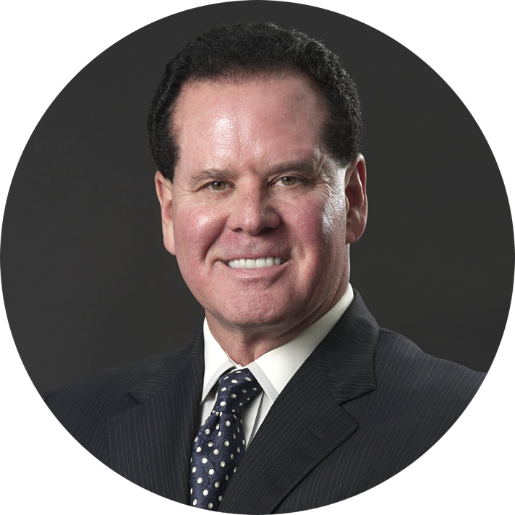
As a proven entrepreneur, thought-leader, and business owner for over 30 years, Barry Cocheu is a seasoned veteran of the Network Marketing Industry.
After developing and shepherding numerous organizations to well over $930 million in sales, Barry’s expertise in managing and leading organizations, as well as defining culture and brand development, is a well-established catalyst for success.
As CEO & Co-Founder of Wellness BioSciences Rx, Barry is excited to focus his years of experience and talent on this quickly developing new industry.
Background Info
Barry Cocheu
CEO & Co-Founder

Slide 3
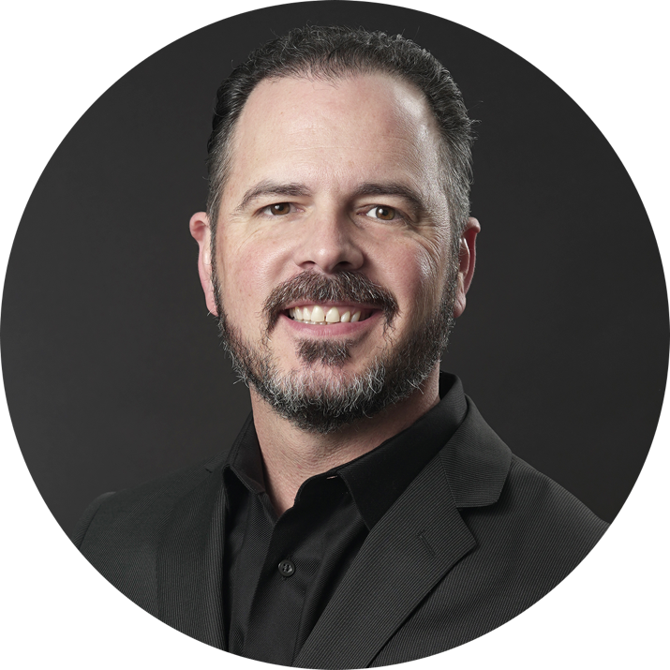
As a successful entrepreneur, combat veteran, and business owner for more than 15 years, Sean Baker has seen it all.
With professional experience that ranges from overseeing a multi-million dollar division of a Fortune 200 company, building a network marketing organization that sold in excess of $11 million dollars, and founding a Congressionally-recognized Alzheimer’s care company, Sean is an expert at inspiring individuals and developing, cultivating, and leading sales organizations.
As the President & Co-Founder of Wellness BioSciences Rx, Sean brings a tremendous boost in passion, capability, and limitless potential to the health and wellness industry.
Background Info
Sean M. Baker
President & Co-Founder

Slide 4
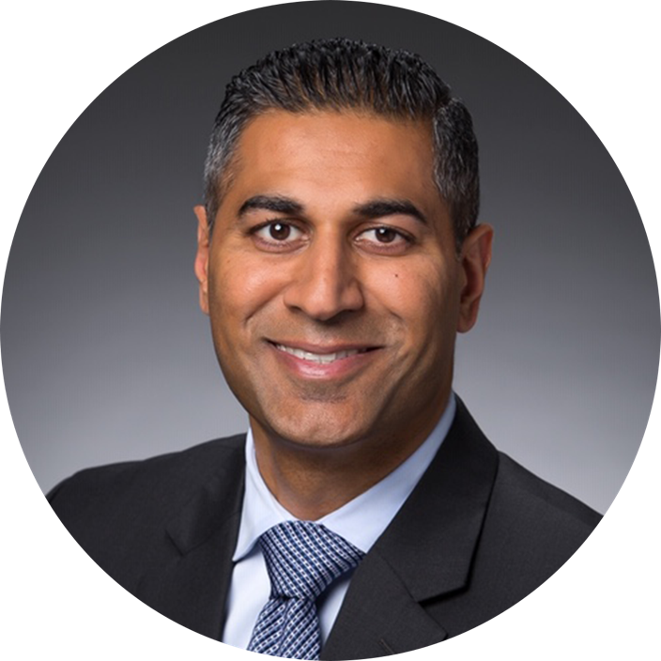
Dr. Nikesh Jasani is a practicing board certified Medical Oncologist. He was born and raised in Houston, TX, and graduated from Houston Baptist University in 1998.
Dr. Jasani graduated from St. George's School of Medicine in 2003 and completed his residency and fellowship at the University of Florida in Jacksonville, FL, then settled in Houston, TX, in 2008.
He has a large general oncology practice and is passionate about delivering high-quality cancer care in the community for his patients.
He believes that compassionate and empathetic care are essential throughout the cancer patient’s journey and takes great privilege in helping patients deal with life threatening diseases. He is currently practicing in the Houston area.
Background Info
Dr. Nikesh Jasani
Founding Partner

Slide 5
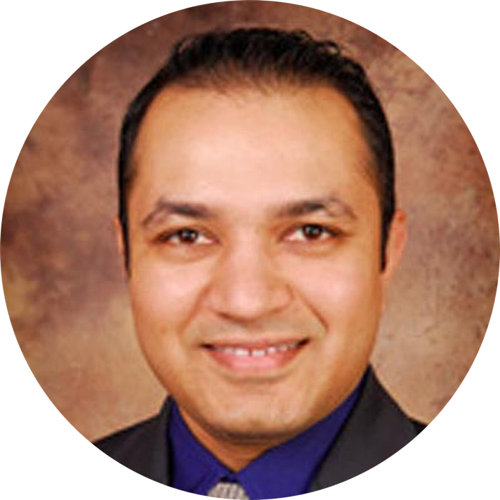
Dr. Nimesh Patel is an Internal Medicine physician currently practicing with Montgomery Physician Associates in Montgomery County, Texas. Prior to his current practice, Dr. Patel served as a physician and board member of the board of managers for the Sadler Clinic in Conroe, Texas.
After practicing for two years as a hospitalist physician in Cincinnati before returning in 2006 to his home city of Houston, Dr. Patel began his Internal Medicine practice as a way to give back to the community where he was raised. Graduating cum laude from Houston Baptist University and the Ross University School of Medicine, Dr. Patel has a passion for post-acute elderly care and his practice is dedicated to caring for the elderly in the community.
Dr. Patel believes that physician participation in healthcare entities has a direct and substantial impact on the quality of care and is proud to add his considerable professional insight, expertise, and physician’s perspective to the mission of Wellness BioSciences Rx.
Background Info
Dr. Nimesh Patel
Chief Wellness Officer

Slide 6
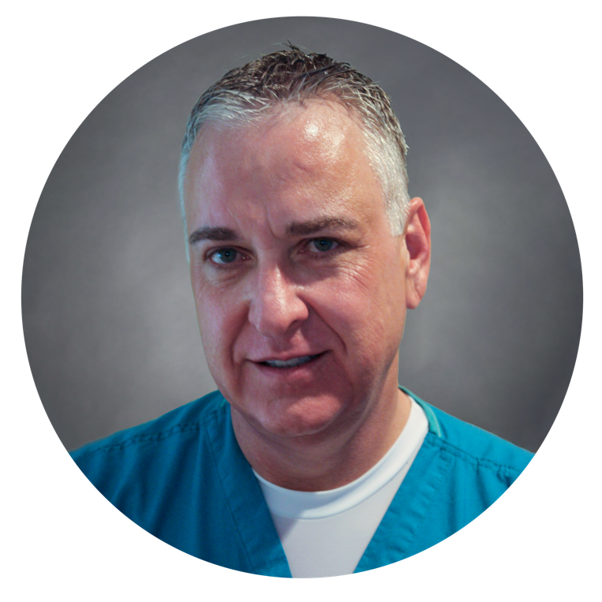
Background Info
Dr. Ken Hollis graduated from the University of Kansas School of Medicine, Kansas City, KS, in 1979. He completed his Straight Surgical Internship and General Surgery Residency at Wesley Medical Center, Wichita, KS, 1979-1984. His Post Residency Training was in Trauma/Critical Care M.I.E.M.S.S in Baltimore, MD, 1985.
A board-certified surgeon, Dr. Hollis is currently retired from clinical practice and serves as a Consultant for BayChoice Healthcare Consultants. He’s also involved in telemedicine, telesurgery proctoring, and clinical research with KDunn & Associates, Houston, TX.
His recent practice includes Metro Vein Centers, Houston, TX, dedicated to minimally invasive management of chronic venous disease. He retired from BayChoice Surgeons, Houston, TX, in 2018, where he practiced General Surgery/Bariatric Surgery.
Dr. Ken Hollis, MD, FACS
WBRx Clinical Program Director

Slide 7
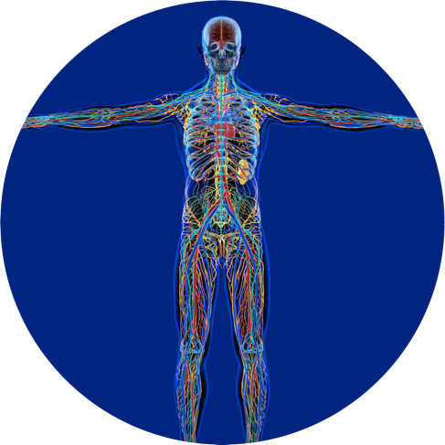
The Science
THE E.C.S.
IMMUNE SYSTEM
CARDIOVASCULAR
SYSTEM
Recently discovered
Medical breakthrough
Engine of homeostasis
Regulates all other body systems
Fueled by cannabinoids
RENAL
SYSTEM
MAJOR
BODY
SYSTEMS
DIGESTIVE
SYSTEM
NERVOUS
SYSTEM
ENDOCRINE
SYSTEM
RESPIRATORY
SYSTEM
EXOCRINE
SYSTEM
REPRODUCTIVE
SYSTEM
MUSCULAR/SKELETAL
SYSTEM

Slide 8
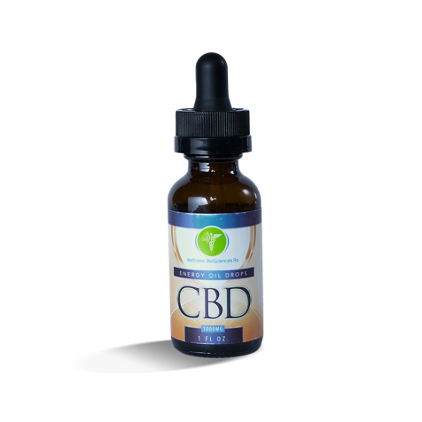
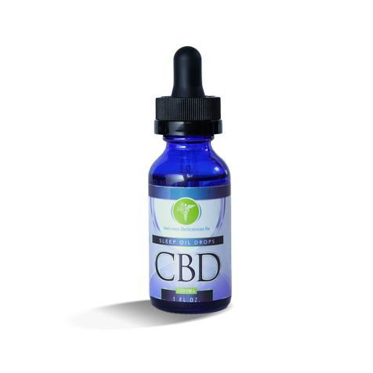
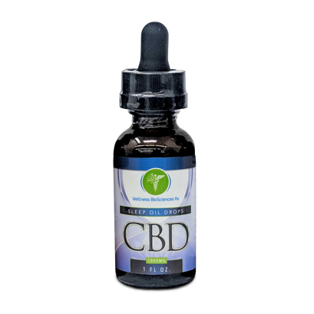
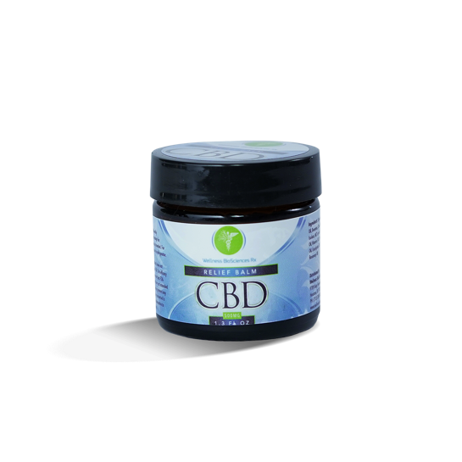
1
The Solution
2
Cannabinoids
Terpenes
7
Complete approach
Nourish the ECS with 400 known compounds
Entourage effect
Proteins
3
Flavonoids
6
4
Omegas
5
Vitamins
Minerals

Slide 9
1
The Solution
2
Cannabinoids
Terpenes
7
Complete approach
Nourish the ECS with 400 known compounds
Entourage effect
Proteins
3
Flavonoids
6
4
Omegas
5
Vitamins
Minerals

Slide 10
The Technology
Exclusive proprietary to WBRx
Makes oil water soluble
Rapid onset of action
Unprecedented absorption
Long-lasting bioavailability

Slide 11
Endocannabinoids (Brain Derived)
Phytocannabinoids (Plant Derived)
Synthetic Cannabinoids (Pharmaceutical Lab)
Food: Omega-3s & Omega 6s
Buds, Tinctures, Extracts
Patented Synthetic Compound
THC, CBD, CBN, etc.
Anadamide (AEA)
THC-only (Marinol)
Endocannabinoid Receptors

Slide 12
CB1 is found mostly in the brain
The Cannabinoid Receptors are Further Divided Into 2 Main Subtypes Known as CB1 and CB2
CB2 receptors are mostly found within the immune system

Slide 13
Basal Ganglia¹ Movement
Concentration of CB1 Receptors
Cerebral Cortex¹ Higher cognitive function
Cerrebellum¹ Movement
Hypothalamus² Appetite
Medulla^{3,4} Nausea/vomiting, chemoreceptor trigger zone (CTZ
Hippocampus¹ Learning, memory, stress
Spinal Cord¹ Peripheral sensation including pain
1. Joy JE. et al, eds. Marijuana and Medicine: Assessing the Science Base. Washington, DC: National Academy Press: 1999: 33-81. 2. Martin BR. et al. J. Support Oncol. 2004:2(4):305-316. 3. Grobenhermen F. Curr Drug Targets CNS Neurol Discord: 2005:4(5):507-530. 4. Navarei RM. et al. Expert Opin Emerg Drugs. 2006:11(1):137-151

Slide 14
CBDA
Inhibits cancer cell growth
Reduces inflammation
CBDA
△9-THCA
Aids sleep
Inhibits cancer cell growth
Suppresses muscle spasms
CBC
Aids sleep
Inhibits cancer cell growth
Promotes bone growth
Slows bacterial growth
CBC
CBD
CBGA
Antibacterial
Inhibits cancer cell growth
Neuro-protective
Promotes bone growth
Reduces seizures and convulsions
Reduced function in the immune system
Reduces inflammation
Reduces risk of artery blockage
Reduces small intestine contractions
Reduces vomiting and nausea
Relieves pain
Relieves anxiety
Slows bacterial growth
Suppresses muscle spasms
Tranquilizing
Treats psoriasis
Vasorelaxant
△9-THC
Reduces vomiting and nausea
Relieves pain
Stimulates appetite
Suppresses muscle spasms
CBGA
Reduced inflammation
Relieves pain
Slows bacterial growth
CBC
CBCA
△8-THC
Relieves pain
CBC
Inhibits cancer cell growth
Promotes bone growth
Reduces inflammation
Relieves pain
△9-THCA
THCV
Reduces convulsions and seizures
Promotes bone growth
△9-THC
CBCA
Reduces inflammation
Treats fungal infection
△8-THC
THCV

Slide 15
This is a product which data shows is safe and has real beneficial physiologic effects in the body.
We do not have data or evidence-based data that CBD or THC cure or treat diseases- cancer, inflammatory bowel, depression etc.
There are a host of ailments in which CBD offers substantial improvement with minimal side effects:
CBD is a Wellness Product……
Mild anxiety/stress
Insomnia
Fibromyalgia
Mild inflammatory pain/arthritis
Gut spasticity/pain (IBS and inflammatory bowel symptoms)
Seizure disorder
Concentration/focus and ADHD

Slide 16
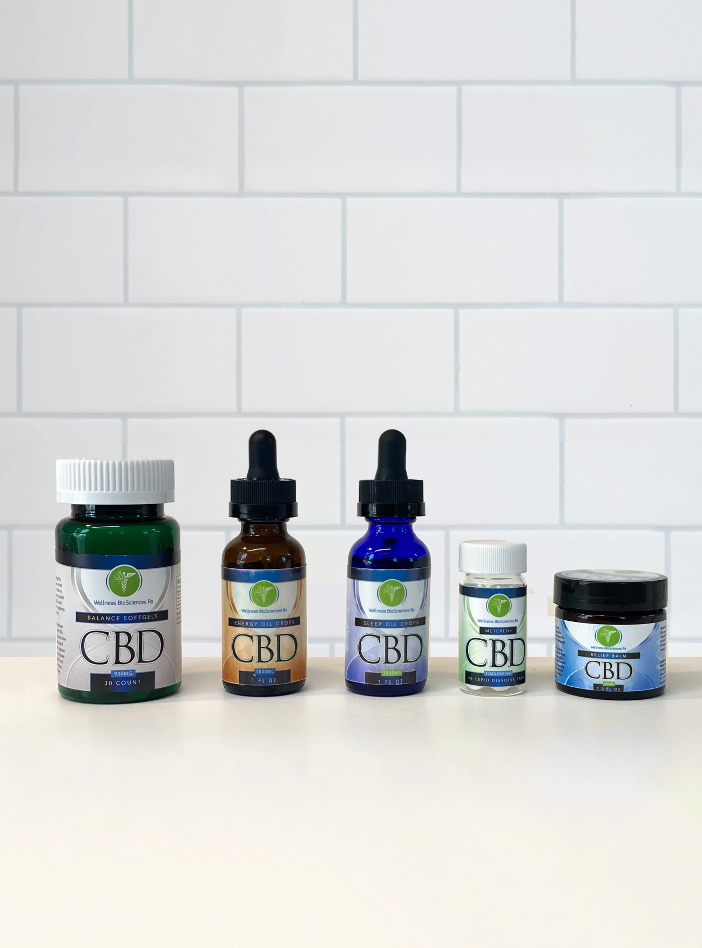
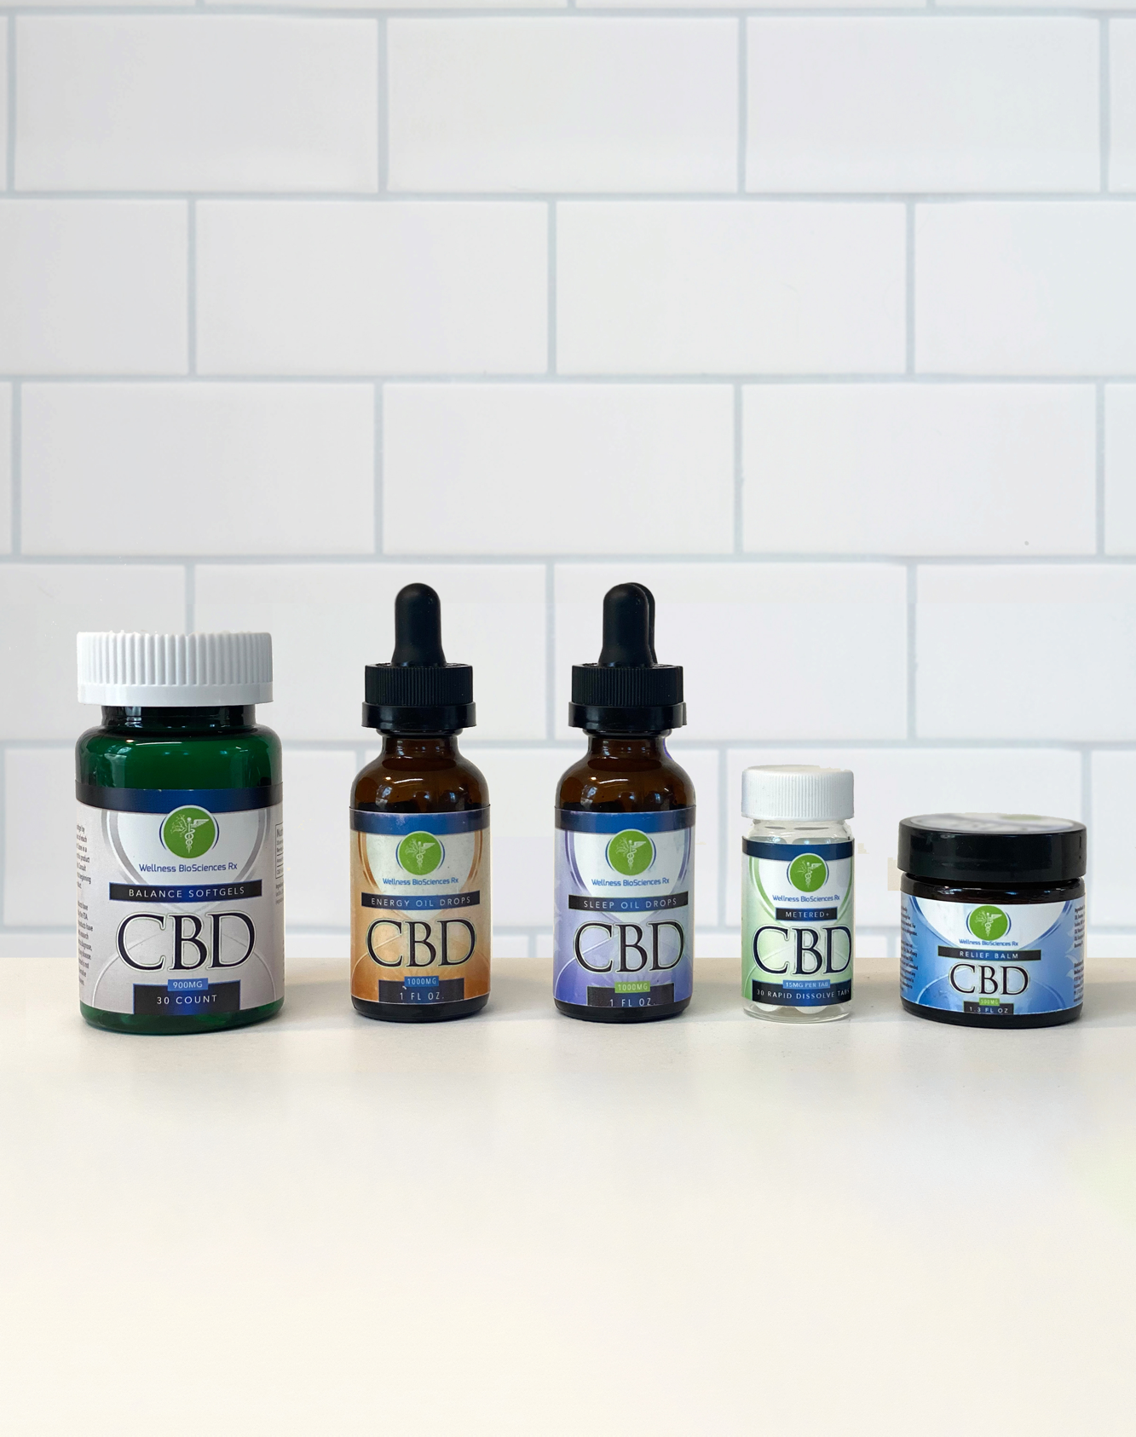
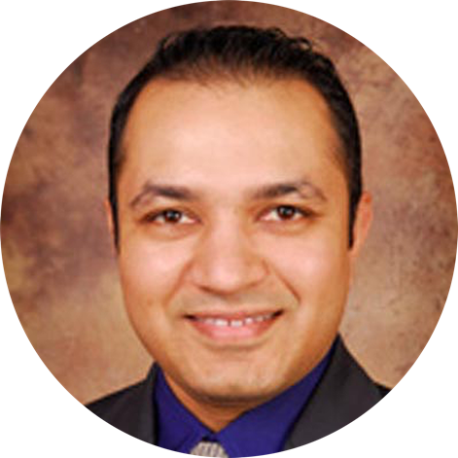
The Gold Standard
Organically sourced
Natural extraction
Superior formulation
System Specific
Multiple Testing
Physician Referred
Our products work!
Dr. Nimesh Patel
Dr. Nikesh Jasani
CHIEF WELLNESS OFFICER
FOUNDING PARTNER

Slide 17
The Future
700% growth by 2020
$22 billion by 2022
1 trillion by 2030

Slide 18
You don’t have to look very far to discover that the state of our healthcare system is struggling and dysfunctional right now. You’ve probably experienced a measure of it yourself—what you may not know though, is how many medical professionals are equally frustrated and discontent with the “state of care” in our country.
The Problem With Healthcare…….

Slide 19
Forced by insurance companies to expedite appointments, maximize billings, and marginalize patients with unconventional needs, many healthcare providers are expressing a strong feeling of disconnect between what they do every day, and the ideal of “helping and healing” what originally drew them to their profession.
This disconnect is further aggravated by pressure from pharmaceutical companies to “diagnose towards” new and profitable drugs, limiting or even preventing them from offering more diverse, personalized solutions that veer outside of conventional pharmaceutical options.
The Problem With Healthcare……

Slide 20
Disease or “Curative” Paradigm
2015
$1.9 Trillion
in 2015 spent
in Disease
Paradigm
2010
Years
Disease Paradigm

Slide 21
Disease or “Curative” Paradigm vs. Wellness Paradigm
2015
2025
Over $700
Billion in
preventative
healthcare in
2015
2010
2015
Years
Years
Disease Paradigm
Wellness Paradigm

Slide 22
Disease or “Curative” Paradigm vs. Wellness Paradigm
2015
2025
$2 Trillion (mostly cash
& profitable)
will be spent
annually
by 2025
10 Years
2010
2015
Years
Years
Disease Paradigm
Wellness Paradigm

Slide 23
Disease or “Curative” Paradigm vs. Wellness Paradigm
2015
2025
Bridge the Disconnect
Provide Wellness
For Healthcare
Professionals &
Organizations
2010
2015
Years
Years
Disease Paradigm
Wellness Paradigm

Slide 24
Incorporates Wellness Into Your Practice
A Program That
Meets your desire to enhance lifestyle modification as a means to treat or prevent disease.
Provides a value-added service that directs your patients to higher quality pure CBD alternative to dangerous drugs.
Gives you confidence your patients have knowledge of, and access to, safe and efficacious products.
Multiple clinical research and evidence supports the use of CBD.
Provides your practice with an additional passive revenue stream without adding employees, increasing overhead, or patient volume.

Slide 25
Current market growth with global expansion on the horizon!
v
v
v
v
v

Slide 26
Current market growth with global expansion on the horizon!
v
v
v
v
v
v
v
v
v
v
v
v
v
v
v
v
v
v
v
v
v
v
v
v
v
v
v
v
v
v
v

Slide 27
Current market growth with global expansion on the horizon!
v
v
v
v
v
v
v
v
v
v
v
v
v
v
v
v
v
v
v
v
v
v
v
v
v
v
v
v
v
v
v
v
v
v
v
v
v
v
v
v
v
v

Slide 28
Current market growth with global expansion on the horizon!
v
v
v
v
v
v
v
v
v
v
v
v
v
v
v
v
v
v
v
v
v
v
v
v
v
v
v
v
v
v
v
v
v
v
v
v
v
v
v
v
v
v
v
v
v
v
v
v
v
v
v
v
v
v
v
v
v

Slide 29
Current market growth with global expansion on the horizon!
v
v
v
v
v
v
v
v
v
v
v
v
v
v
v
v
v
v
v
v
v
v
v
v
v
v
v
v
v
v
v
v
v
v
v
v
v
v
v
v
v
v
v
v
v
v
v
v
v
v
v
v
v
v
v
v
v

Slide 30
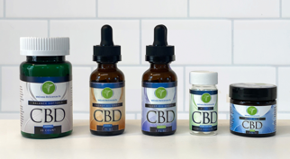
1
The 6 Step
Marketing Program
Use the products
2
Share your story
3
Share samples
4
Wholesale / Retail
5
Share the Opportunity
6
Sort
Copy…

Slide 31
Compensation Plan
1
RETAIL
PROFITS
Several ways to earn
Set your own hours
Work from home
Unlimited potential
2
3
PRODUCTION
BONUSES
RESIDUAL
INCOME

Slide 32
Unlimited Duplication
Duplicate the 6 Step Program
5x5 creates large growth income
Up to $14K immediate income
Up to 12% on residual earnings
Earn through 6 generations
PRESIDENT’S PARTNERSHIP
CLUB
Up to 40% on customers and 12% down 6 generations
REGIONAL
DIRECTOR
Up to 30% on customers
and 4% down 4 generations
NATIONAL
MARKETING
DIRECTOR
Up to 35%
on customers and 8% down 5 generations
EXECUTIVE
Up to 20%
on customers
and 4% down 2 generations
DIRECTOR
Up to 25% with a 5% production bonus on customers
and 4% down 3 generations
BRAND
PARTNER Up to 10% on customers
MANAGER
Up to 15% on customers and 4% on royalties down 1 generation

Slide 33
Power of Duplication

Slide 34
Residual Income
Generation | Royalty | Team
1 | 4% | 5
2 | 4% | 25
3 | 4% | 125
4 | 4% | 625
5 | 8% | 3,125
6 | 12% | 15,625
Achieve PPC and unlock unlimited potential
Get paid monthly
Every product sold
Up to six generations
Duplicate the 5x5
Do the math

Slide 35
Get Involved
Choose your enrollment pak today with added discounts available!
Manager Pak
Executive Pak
Director Pak
Regional Director Pak
National Marketing
Director Pak
President’s Partnership
Club Pak
Contact base
Credibility within your contact base
Your financial situation

Slide 36
The Wellness Practice Retail Revenue Stream
by Recommending Wellness BioSciences Rx Products
3,000 Patient Base Profit Based on 10% Conversion
Discount Earnings | 25% | 35% | 40%
Gross Sales 300 x $150 = $45,000 | $11,250/mo. $135k/yr. | $15,750/mo. $189k/yr. | $18,000/mo $216k/yr.
Gross Sales 300 x $300 = $90,000 | $22,500/mo. $270k/yr. | $31,500/mo. $378k/yr. | $36,000/mo. $432k/yr.

Slide 37
The Wellness Practice Residual Revenue on Healthcare Networks Developed
Brand Partner Program | 4% | 8% | 12%
1 Practice 100 Patients @ $150 $15k/mo. | $360/mo. $4,320/yr. | $720/mo. $8,640/yr. | $1,080/mo. $12,960/yr.
5 Practices $15k/mo. $75k | $1,800/mo. $21,600/yr. | $3,600/mo. $43,200/yr. | $5,400/mo. $64,800/yr.
10 Practices $15k/mo. $150k | $3,600/mo. $43,200/yr. | $7,200/mo. $86,400/yr. | $10,800/mo. $129,600/yr.
20 Practices $15k/mo. $300k | $7,200/mo. $86,400/yr. | $14,400/mo. $172,800yr. | $21,600/mo. $259,200/yr.
*Retail value x 60% = Commissionable Volume (CV)

Slide 38
Benefits Program
Travel Program
Car Program

Slide 39
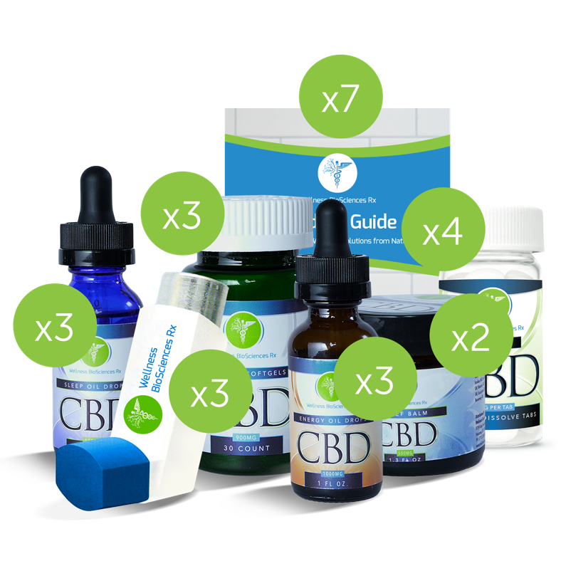
Inventory Description
WBRx Energy
WBRx Sleep
WBRx Balance Softgels
WBRx Relief Balm
WBRx Product Guide
Metered+
WBRx MDI - 5.0
Manager Pak
Price
$109.99
$109.99
$119.99
$99.99
$1.60
$99.99
$129.99
Quantity
3
3
3
2
7
4
3
24
Extended
$329.97
$329.97
$359.97
$199.98
$11.20
$399.96
$389.97
$2,021.02
$1,500.00
Pak Retail Value
Pak Retail Price
Retail Value
$2,021.02
Discount %:
Whole Price:
Retail Price
$1,500.00
15%
$1,275.00

Slide 40
Inventory Description
WBRx Energy
WBRx Sleep
WBRx Balance Softgels
WBRx Relief Balm
WBRx Product Guide
Metered+
WBRx MDI - 5.0
Director Pak
Price
$109.99
$109.99
$119.99
$99.99
$1.60
$99.99
$129.99
Quantity
10
9
10
9
10
10
15
71
Extended
$1,099.90
$989.91
$1,199.90
$899.91
$16.00
$999.00
$1,949.85
$7,155.37
$6,000.00
Pak Retail Value
Pak Retail Price
Retail Value
$7,155.37
Discount %:
Whole Price:
Retail Price
$6,000.00
20%
$4,800.00

Slide 41
Inventory Description
WBRx Energy
WBRx Sleep
WBRx Balance Softgels
WBRx Relief Balm
WBRx Product Guide
Metered+
WBRx MDI - 5.0
NMD Pak
Price
$109.99
$109.99
$119.99
$99.99
$1.60
$99.99
$129.99
Quantity
51
51
51
51
25
25
55
302
Extended
$5,609.49
$5,609.49
$6,119.49
$5,099.49
$40.00
$2,499.75
$7,149.45
$32,127.16
$30,000.00
Pak Retail Value
Pak Retail Price
Retail Value
$32,127.16.80
Discount %:
Whole Price:
Retail Price
$30,000.00
20%
$24,000.00

Slide 42
Inventory Description
WBRx Energy
WBRx Sleep
WBRx Balance Softgels
WBRx Relief Balm
WBRx Product Guide
Metered+
WBRx MDI - 5.0
PPC Pak
Price
$109.99
$109.99
$119.99
$99.99
$1.60
$99.99
$129.99
Quantity
102
102
105
102
50
25
125
604
Extended
$11,218.98
$11,218.98
$12,598.95
$10,198.98
$80.00
$2,499.75
$16,248.75
$64,064.39
$60,000.00
Pak Retail Value
Pak Retail Price
Retail Value
$64,064.39
Discount %:
Whole Price:
Retail Price
$60,000.00
20%
$48,000.00

